Slide 1


Slide 2
Hi, we are
Group 2

Slide 3
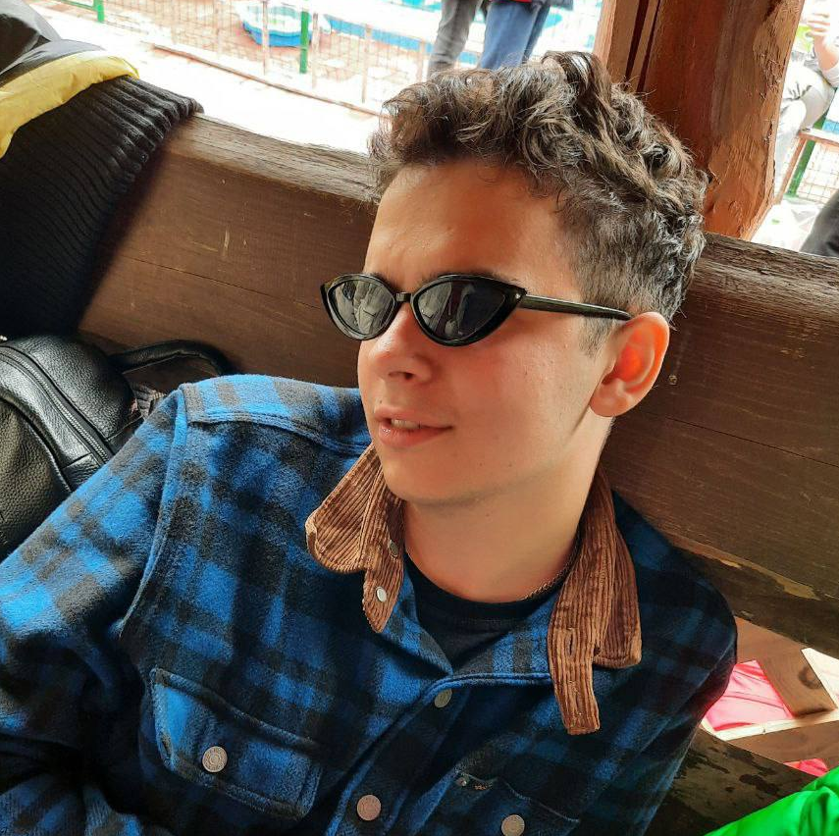
Hovda Bohdan
student of IT STEP University
Hobby: playing videogames, watching Ragulivna and sleeping
Movie: The Wave(2008)
“
Батько наш – Бандера, Україна – мати!
“

Slide 4

Yankiv Dzvinka
student of IT STEP University
Hobby: playing piano, singing, travelling
Movie: Three Steps Above Heaven
“
Follow your heart
“

Slide 5

Pryimak Roman
student of IT STEP University
Hobby: to be a armchair analyst, to sarcastically joke, to draw
Song: Take on me – A-ha
“
Between greater and lesser evil, I would prefer not to choose anything.
“
Andrzej Sapkowski

Slide 6
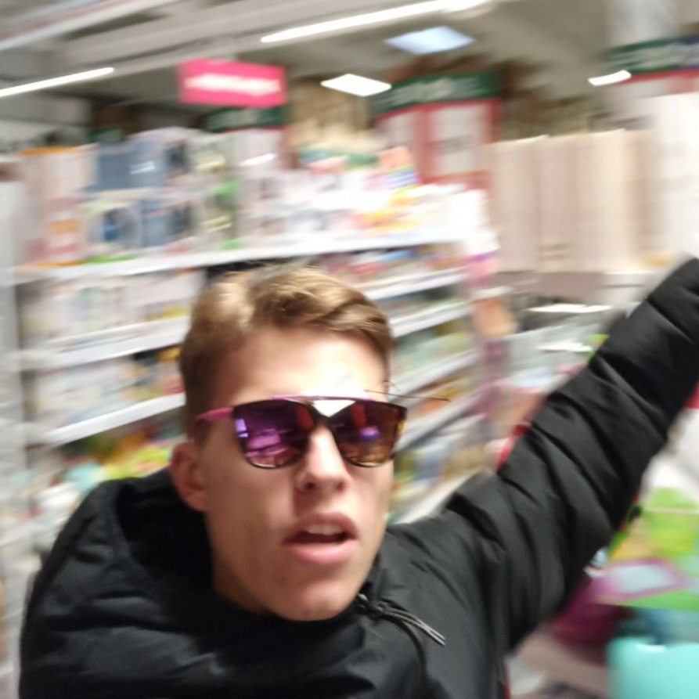
Dubina Dima
student of IT STEP University
Hobby: sport, making money, girls
Movie: The Shawshank Redemption
Music: Earth, Wind & Fire - September
“
“
Make sense.
Andrew Sedler

Slide 7

Iskiv Mykhailo
student of IT STEP University
Hobby: cycling, jogging, watching movies and TV series
Movie: Venom 2: Carnage
“
Don’t be afraid to fail. Be afraid not to try
“
Michael Jordan

Slide 8

Iskiv Mykhailo
student of IT STEP University
Hobby: cycling, jogging, watching movies and TV series
Movie: Venom 2: Carnage
“
Don’t be afraid to fail. Be afraid not to try
“
Michael Jordan

Slide 9






Nova Poshta is "Delivery of the future"
every third Ukrainian uses Nova Poshta
more than 32,000 workers
more than 8,700 branches throughout Ukraine
NovaPoshta Global
more than 300 million parcels and cargoes were shipped in 2020

Slide 10

Nova Poshta is "Delivery of the future"
In 2020, Nova Poshta’s net profit grew by 26.6% - up to
16 903 000 000
UAH
every third Ukrainian uses Nova Poshta
more than 32,000 workers
Paid in taxes and fees to state and local budgets:
more than 8,700 branches throughout Ukraine
NovaPoshta Global
5 000 000 000 UAH
more than 300 million parcels and cargoes were shipped

Slide 11
Now we’ll talk
a bit about:
more about:
In 2020, Nova Poshta’s net profit grew by 26.6% - up to
16 903 000 000
Rating
Budget
Design
Architecture
Testing
CI/CD
Agile
UAH
SDLC
Target audience
Stakeholders
Requirments
Paid in taxes and fees to state and local budgets:
5 000 000 000 UAH

Slide 12
Now we’ll talk
more about:
Systems Development Life Cycle (SDLC)
the systems development life cycle concept applies to a range of
hardware and software configurations, as a system can be composed
of hardware only, software only, or a combination of both. There are
usually six stages in this cycle: requirement analysis, design,
development and testing, implementation, documentation, and
evaluation.
Rating
Budget
Design
Architecture
Testing
CI/CD
Agile

Slide 13
How we understand that:
determine the stages
distribute people in stages
definition of requirements
What it gives us:
clearly define the work plan
correctly distribute the roles for maximum efficiency
determining which product we need
what is needed for this
Systems Development Life Cycle (SDLC)
the systems development life cycle concept applies to a range of
hardware and software configurations, as a system can be composed
of hardware only, software only, or a combination of both. There are
usually six stages in this cycle: requirement analysis, design,
development and testing, implementation, documentation, and
evaluation.

Slide 14
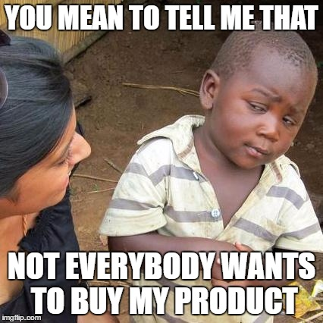
TARGET AUDIENCE are people who can become potential buyers of a product / service.
How we understand that:
determine the stages
distribute people in stages
definition of requirements
What it gives us:
clearly define the work plan
correctly distribute the roles for maximum efficiency
determining which product we need
what is needed for this
Identifying your target audience as a business can help craft marketing strategies and define your core customers. Instead of spending money and resources trying to cater to every consumer, defining a target audience allows for more intentional and personal outreach to those most likely to purchase your product or service.

Slide 15

Target audience of Nova Poshta
TARGET AUDIENCE are people who can become potential buyers of a product / service.
Age: 14+;
Gender: male, female;
Profit level: sufficient;
Main customers: small business, online stores, shipping companies, sellers of goods on the Internet, individuals.
Identifying your target audience as a business can help craft marketing strategies and define your core customers. Instead of spending money and resources trying to cater to every consumer, defining a target audience allows for more intentional and personal outreach to those most likely to purchase your product or service.
Needs and desires: delivery (to the branch, post office, address), international partner delivery network, money transfers, storage of goods in warehouses, picking and sending orders to the recipient;
Geolocation: Ukraine (cities, towns, urban-type settlements, villages); online shopping: USA, Germany, China, Poland, Great Britain, Turkey (amazon, ebay, etc.);

Slide 16
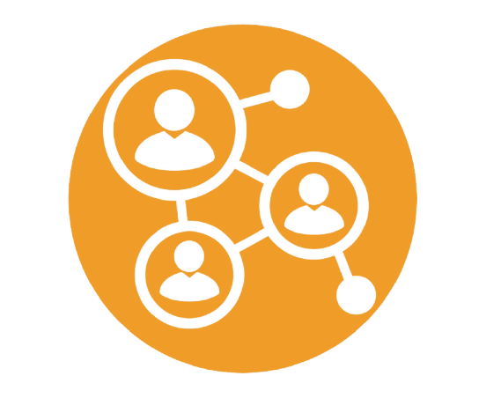
Target audience of Nova Poshta
Stakeholder
a term that describes a
person, group of individuals or
individual organizations whose
actions, behaviors or decisions may
affect the success of the system.
Age: 14+;
Gender: male, female;
Profit level: sufficient;
Main customers: small business, online stores, shipping companies, sellers of goods on the Internet, individuals.
Needs and desires: delivery (to the branch, post office, address), international partner delivery network, money transfers, storage of goods in warehouses, picking and sending orders to the recipient;
Geolocation: Ukraine (cities, towns, urban-type settlements, villages); online shopping: USA, Germany, China, Poland, Great Britain, Turkey (amazon, ebay, etc.);

Slide 17
Stackholders
Stakeholder
a term that describes a
person, group of individuals or
individual organizations whose
actions, behaviors or decisions may
affect the success of the system.
External
Internal
various public organizations and associations that are not used in the education system (political parties, ethnic and other social groups, creative unions, scientific institutions, etc.), but which are interested in social partnership.
different categories of people receiving education (students) and their parents; - research and teaching staff, teaching and support and administrative staff.

Slide 18
Stackholders
Our stackholders
1)Buyer's side
2)Customer
3)Developer
4)Provider
5)User
6)Producer
7)Accompanying party
liquidator
Internal
External
8)Accreditor, or inspector
regulatory body
support staff
instructors
9)Operators
various public organizations and associations that are not used in the education system (political parties, ethnic and other social groups, creative unions, scientific institutions, etc.), but which are interested in social partnership.
different categories of people receiving education (students) and their parents; - research and teaching staff, teaching and support and administrative staff.

Slide 19
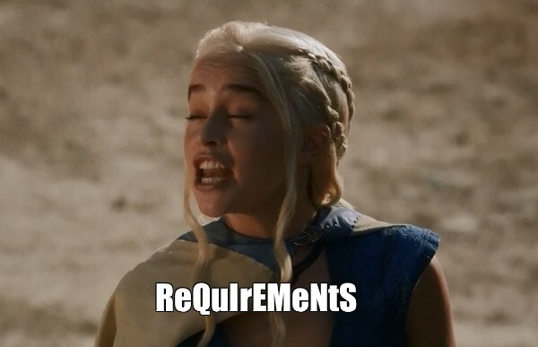
Our stackholders
Requirements
statements that indicate what a system needs to do in
order to provide a capability (i.e. utility or benefit.)
1)Buyer's side
2)Customer
3)Developer
4)Provider
5)User
6)Producer
7)Accompanying party
liquidator
8)Accreditor, or inspector
regulatory body
support staff
instructors
9)Operators
Two types of requirements:
Functional - product features or functions that developers must implement to enable users to accomplish their tasks.
Non-functional - a specification that describes the system’s operation capabilities and constraints that enhance its functionality(speed, security, reliability, etc.)

Slide 20
M
S
C
W
MoSCoW
prioritization scheme
Requirements
statements that indicate what a system needs to do in
order to provide a capability (i.e. utility or benefit.)
Must: The requirement must be satisfied for the solution to be considered a success.
Two types of requirements:
Functional - product features or functions that developers must implement to enable users to accomplish their tasks.
Non-functional - a specification that describes the system’s operation capabilities and constraints that enhance its functionality(speed, security, reliability, etc.)
Should: The requirement is important and should be included in the solution if possible, but it’s not mandatory to success.
Could: It’s a desirable capability, but one that could be deferred or eliminated. Implement it only if time and resources permit.
Won’t: This indicates a requirement that will not be implemented at this time but could be included in a future release

Slide 21

M
S
Key requirements
C
W
MoSCoW
prioritization scheme
Must: The requirement must be satisfied for the solution to be considered a success.
Personal cabinet
My parcels
Should: The requirement is important and should be included in the solution if possible, but it’s not mandatory to success.
Could: It’s a desirable capability, but one that could be deferred or eliminated. Implement it only if time and resources permit.
Сreate a parcel
Map of branches
Won’t: This indicates a requirement that will not be implemented at this time but could be included in a future release

Slide 22
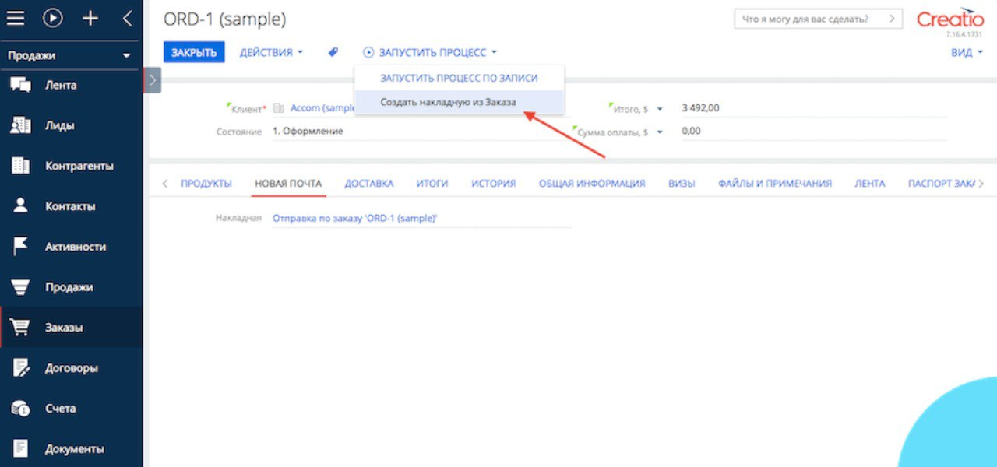

Features or bugs?
M
S
Key requirements
C
W
MoSCoW
prioritization scheme
CRM + Nova Poshta
Must: The requirement must be satisfied for the solution to be considered a success.
Personal cabinet
My parcels
Should: The requirement is important and should be included in the solution if possible, but it’s not mandatory to success.
Could: It’s a desirable capability, but one that could be deferred or eliminated. Implement it only if time and resources permit.
Сreate a parcel
Map of branches
Won’t: This indicates a requirement that will not be implemented at this time but could be included in a future release

Slide 23
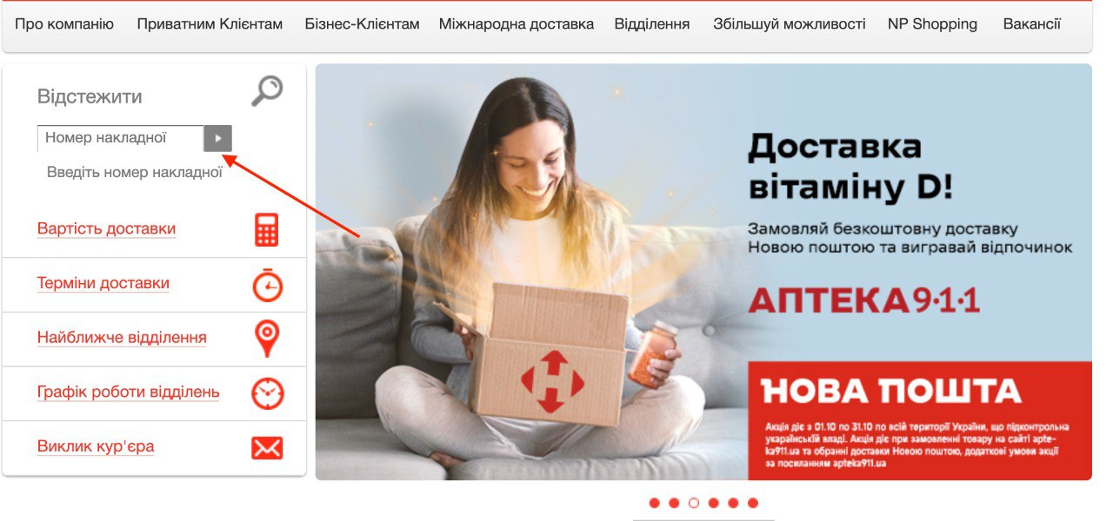
Features or bugs?
Tracking of the parcel
CRM + Nova Poshta

Slide 24
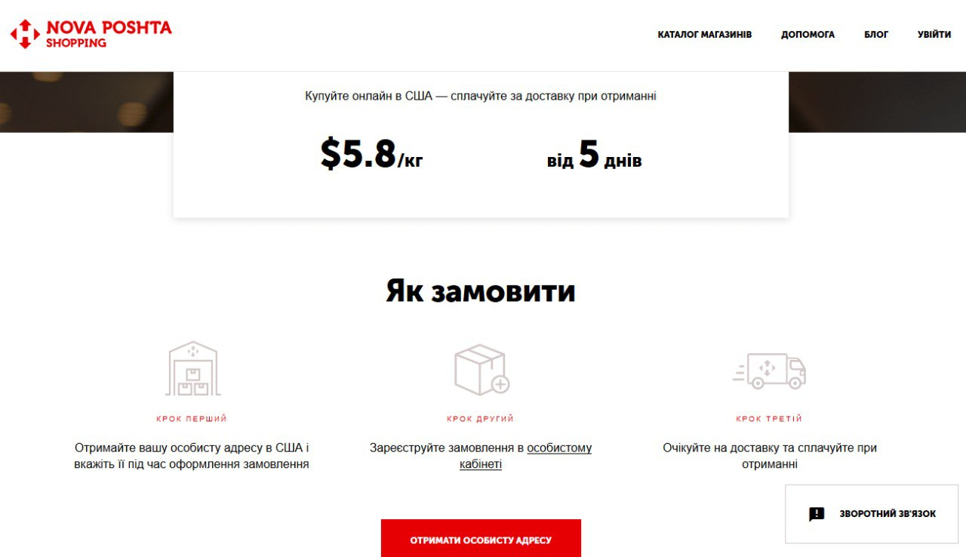

Tracking of the parcel
Nova Poshta Shopping
Shopping

Slide 25

Nova Poshta Shopping
Estimation
Estimation techniques:
Delphi Technique
Work Breakdown Structure (WBS)
Three Point Estimation
Functional Point Method
is prediction to determine how much effort and time it would take to complete a defined task.
Evaluation phase of the SDLC is the post-implementation review.
Aim: to deploy the system and train the system end users.

Slide 26
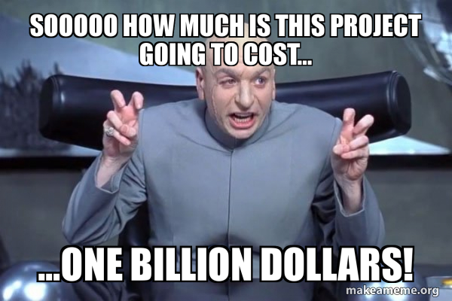
What is a Budget?
Estimation
Estimation techniques:
Delphi Technique
Work Breakdown Structure (WBS)
Three Point Estimation
Functional Point Method
Really? Do we need to say about it?
Okaaaay
is prediction to determine how much effort and time it would take to complete a defined task.
Evaluation phase of the SDLC is the post-implementation review.
Aim: to deploy the system and train the system end users.
A project budget is the total sum of money allocated for the particular purpose of the project for a specific period of time.

Slide 27
What is a Budget?
Total budget | $52,698
Backend | $20,108
Frontend | $8,213
Design | $9,878
Quality Assurance | $6,608
Project Management & Coordination | $5,192
Project duration | 1,161 hrs
A project budget is the total sum of money allocated for the particular purpose of the project for a specific period of time.

Slide 28
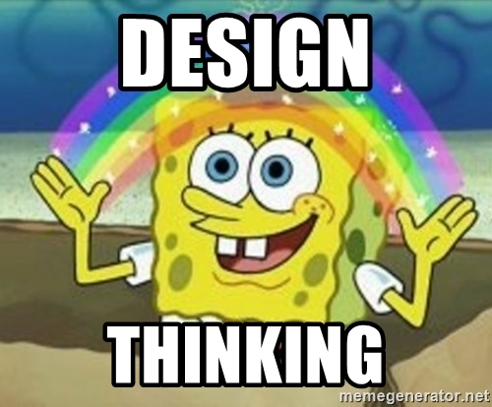
Total budget | $52,698
Backend | $20,108
Frontend | $8,213
Design | $9,878
Quality Assurance | $6,608
Project Management & Coordination | $5,192
Project duration | 1,161 hrs
Design Thinking
a non-linear, iterative process that teams use to understand users, challenge assumptions, redefine problems and create innovative solutions to prototype and test. Involving five phases -- Empathize, Define, Ideate, Prototype and Test -- it is most useful to tackle problems that are ill-defined or unknown.

Slide 29
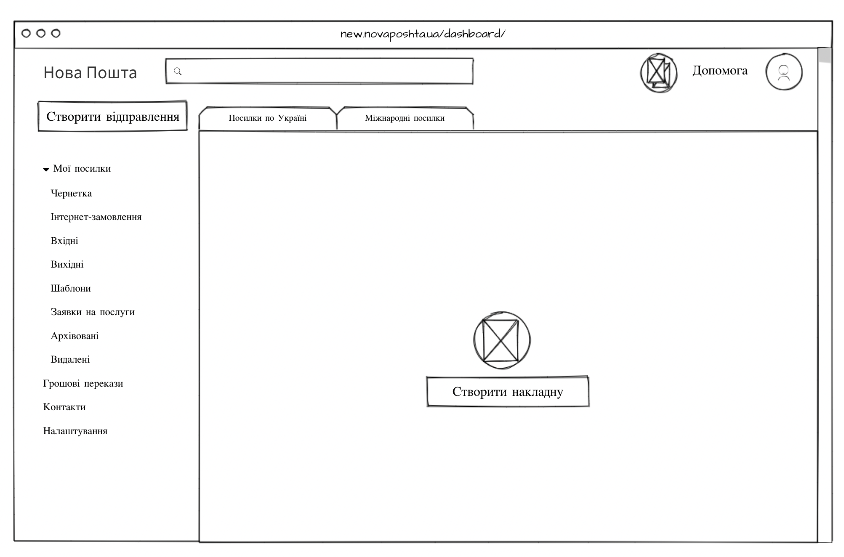
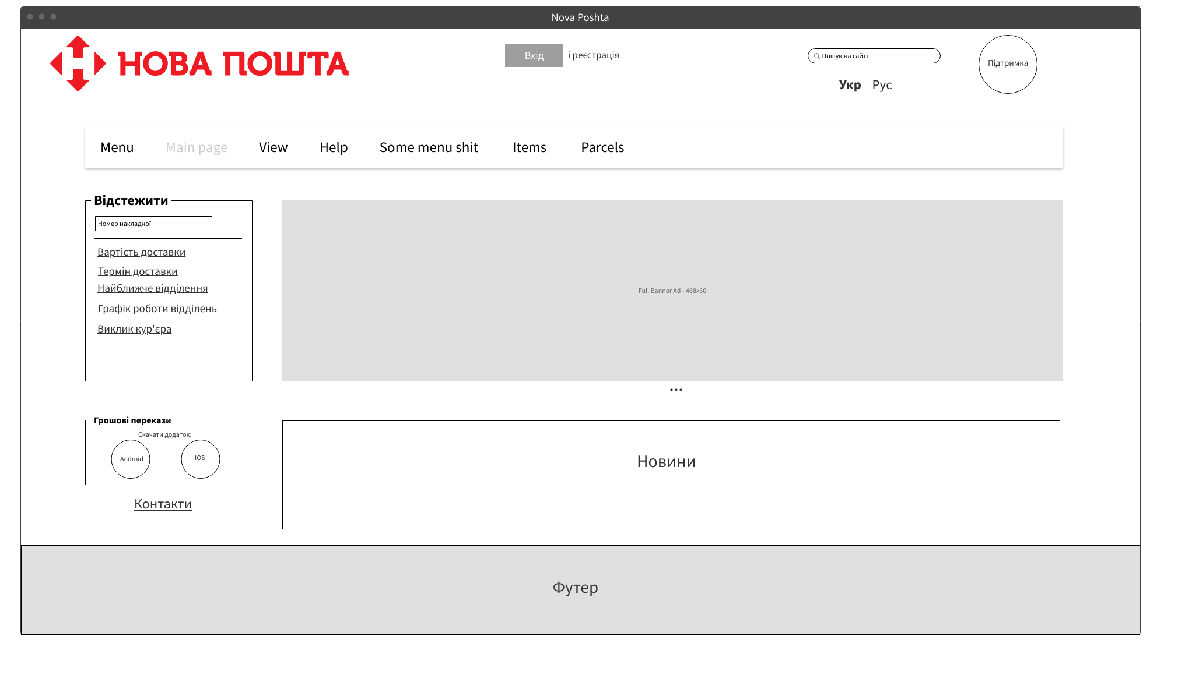
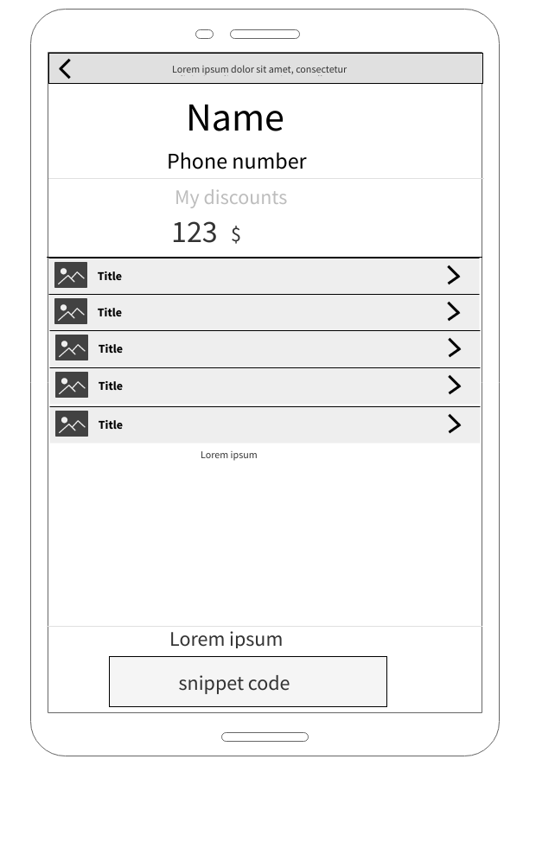
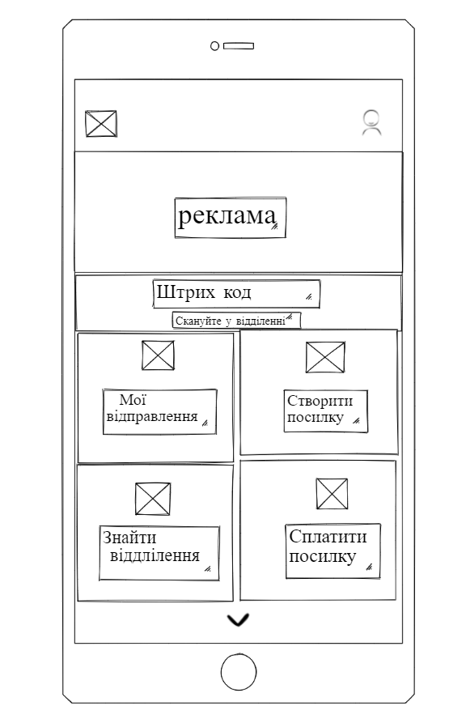
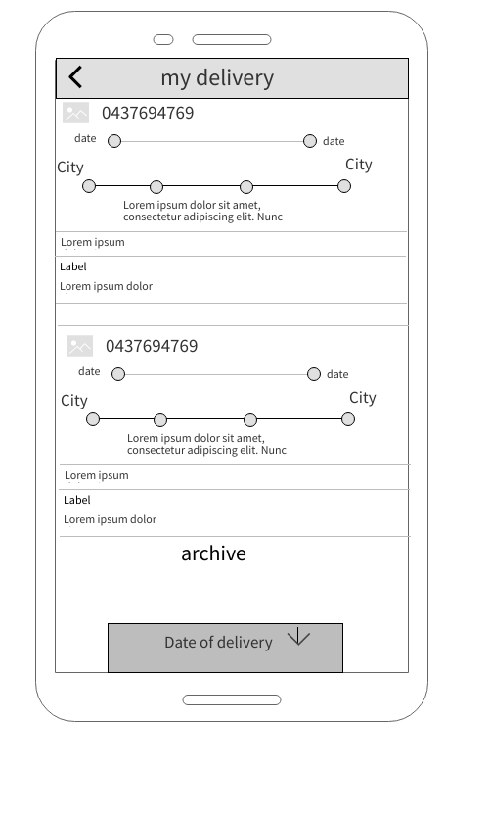
Design Thinking
a non-linear, iterative process that teams use to understand users, challenge assumptions, redefine problems and create innovative solutions to prototype and test. Involving five phases -- Empathize, Define, Ideate, Prototype and Test -- it is most useful to tackle problems that are ill-defined or unknown.

Slide 30
Project Architecture
the organization (or chunking) of a product’s functional elements. It’s the ways these elements, or chunks, interact. It plays a significant role in how to design, make, sell, use, and repair a new product offering. Linking to system- level design and the principles of system engineering.

Slide 31
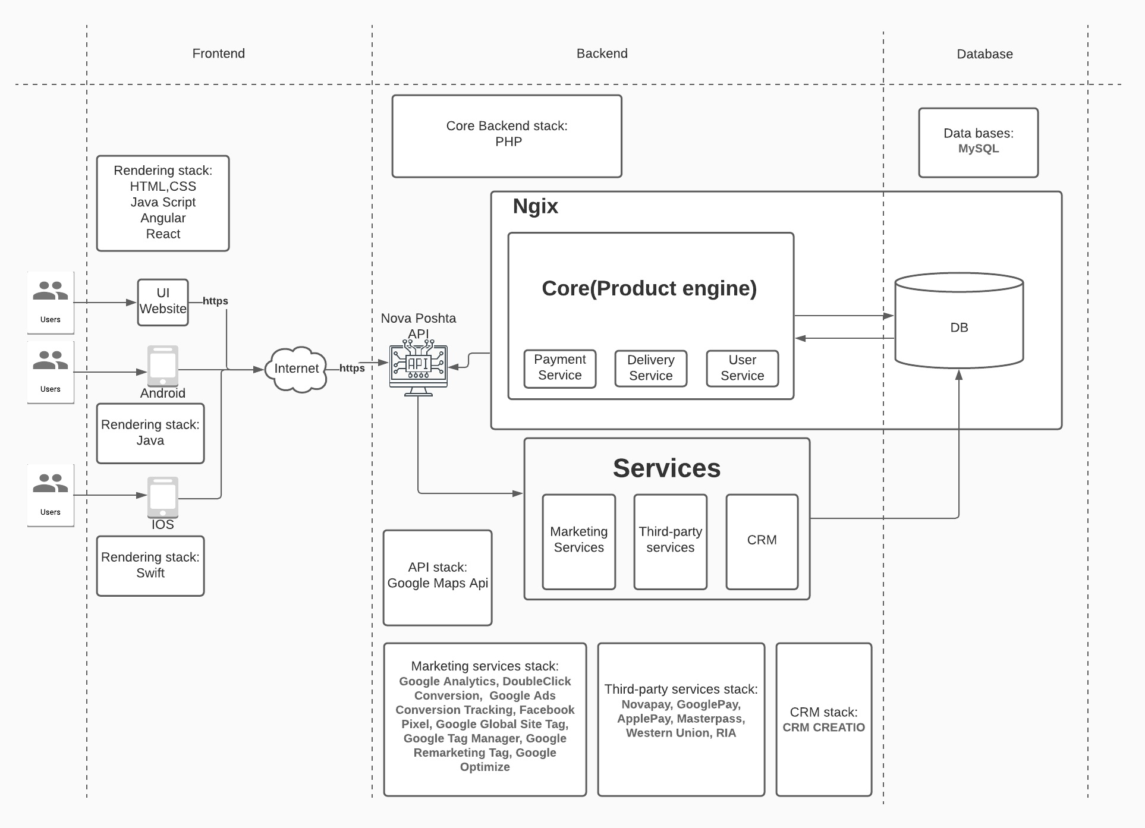
Project Architecture
the organization (or chunking) of a product’s functional elements. It’s the ways these elements, or chunks, interact. It plays a significant role in how to design, make, sell, use, and repair a new product offering. Linking to system- level design and the principles of system engineering.

Slide 32
CI/CD?
Don’t hear about this? We too, but Misha will explaine😊
a method to frequently deliver apps to customers by introducing automation into the stages of app development. The main concepts attributed to CI/CD are continuous integration, continuous delivery, and continuous deployment. CI/CD is a solution to the problems integrating new code can cause for development and operations teams (AKA "integration hell").

Slide 33
CI/CD?
a method to frequently deliver apps to customers by introducing automation into the stages of app development. The main concepts attributed to CI/CD are continuous integration, continuous delivery, and continuous deployment. CI/CD is a solution to the problems integrating new code can cause for development and operations teams (AKA "integration hell").
Має бути картинка з якимись вузлами з гітхабу, які не знати де взяти

Slide 34
Testing
Types of testing:
Functional testing
Non-functional testing
Structural testing
Testing changes
refers to the actual testing of a product to meet QC standards. This may involve using or stress testing the product or seeing if the actual service results match the expected results. The process identifies problems in the product or service before it goes live.
Має бути картинка з якимись вузлами з гітхабу, які не знати де взяти

Slide 35
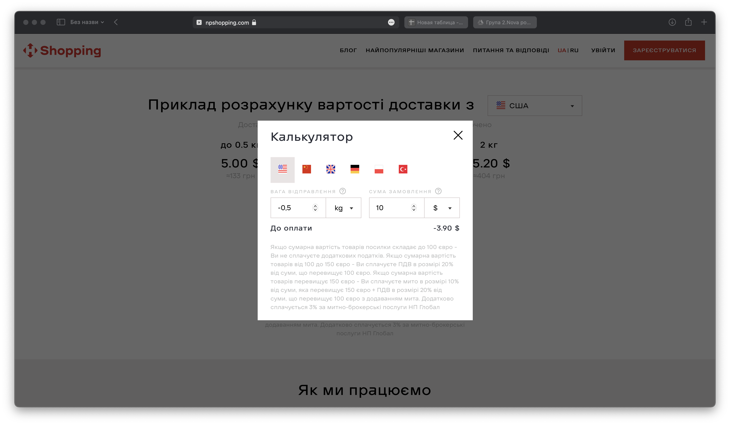
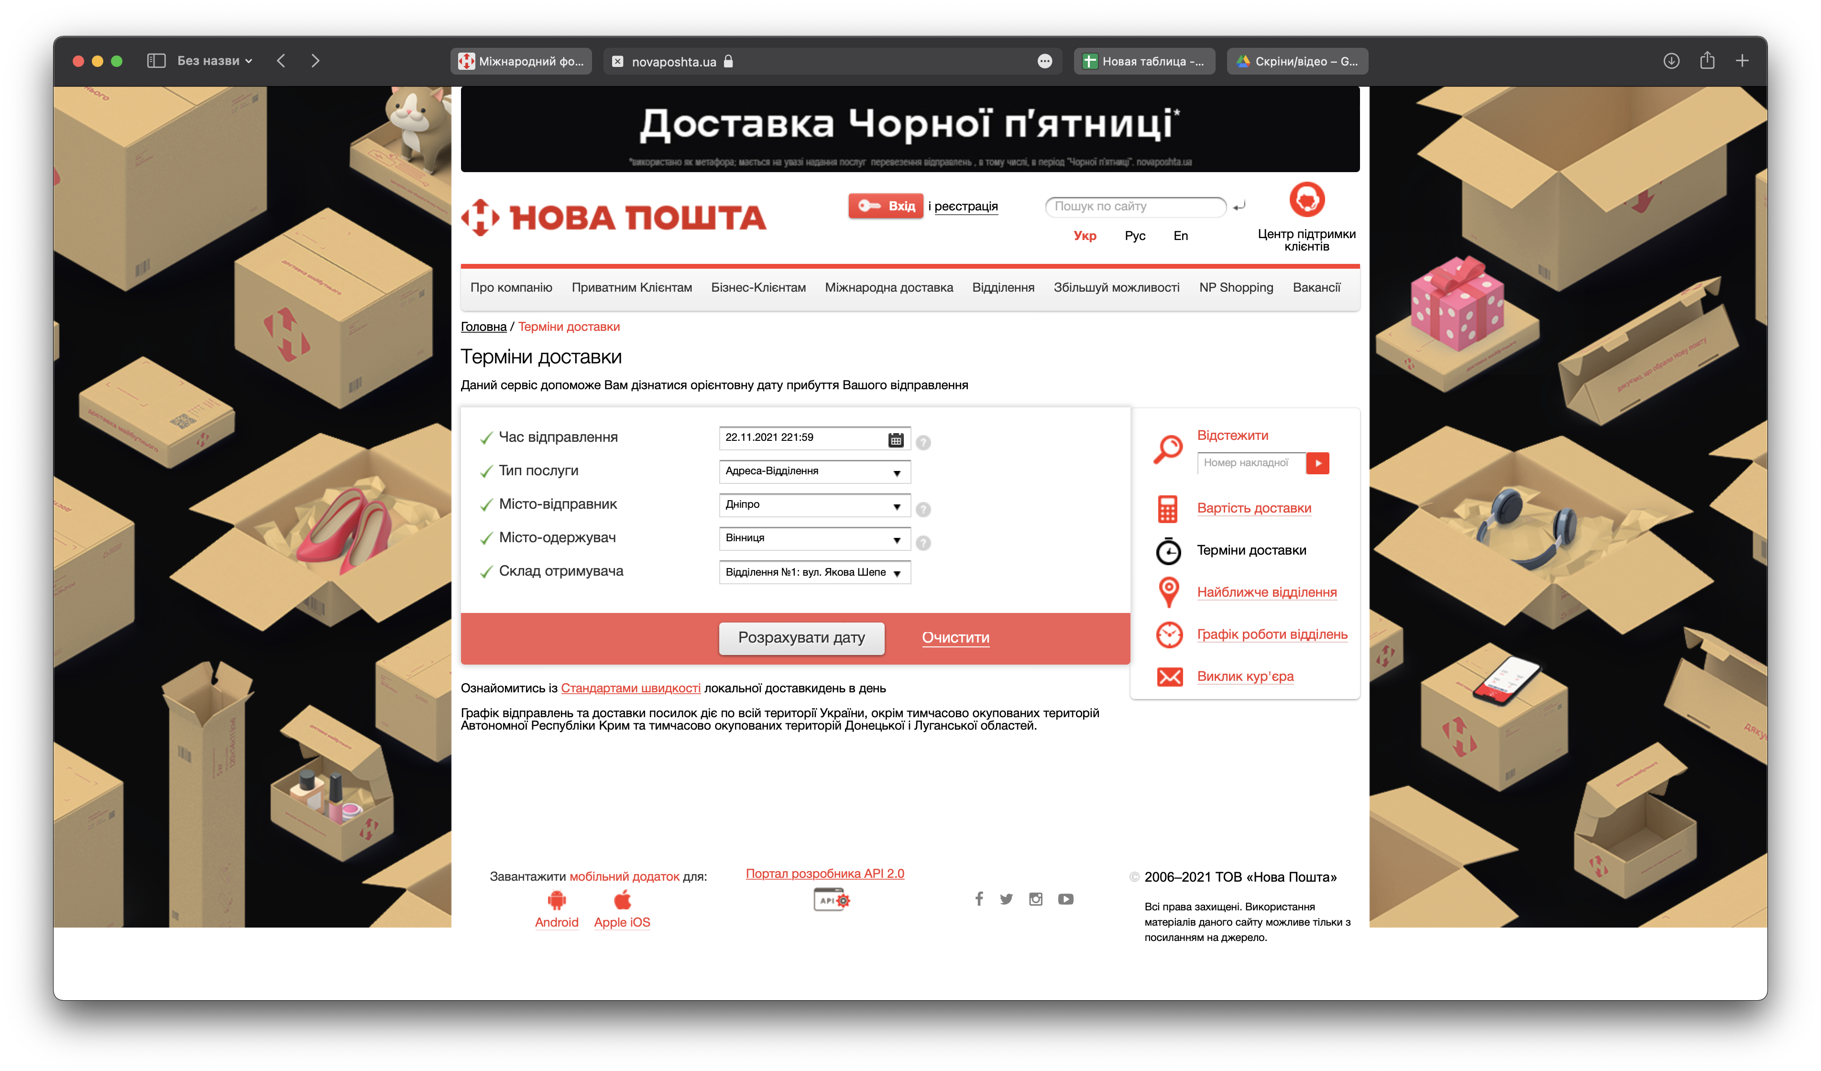
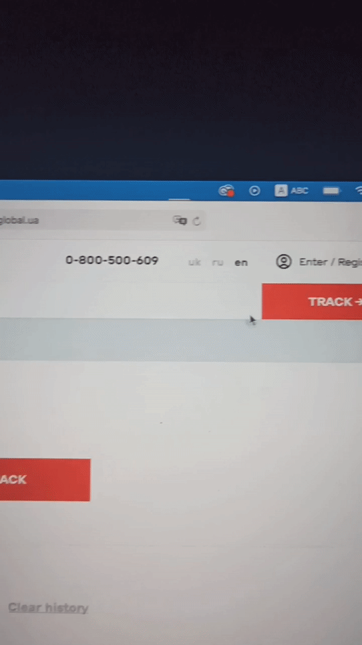
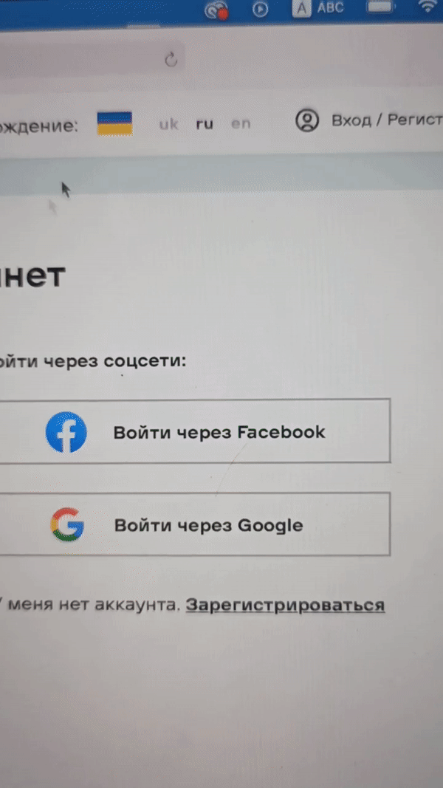

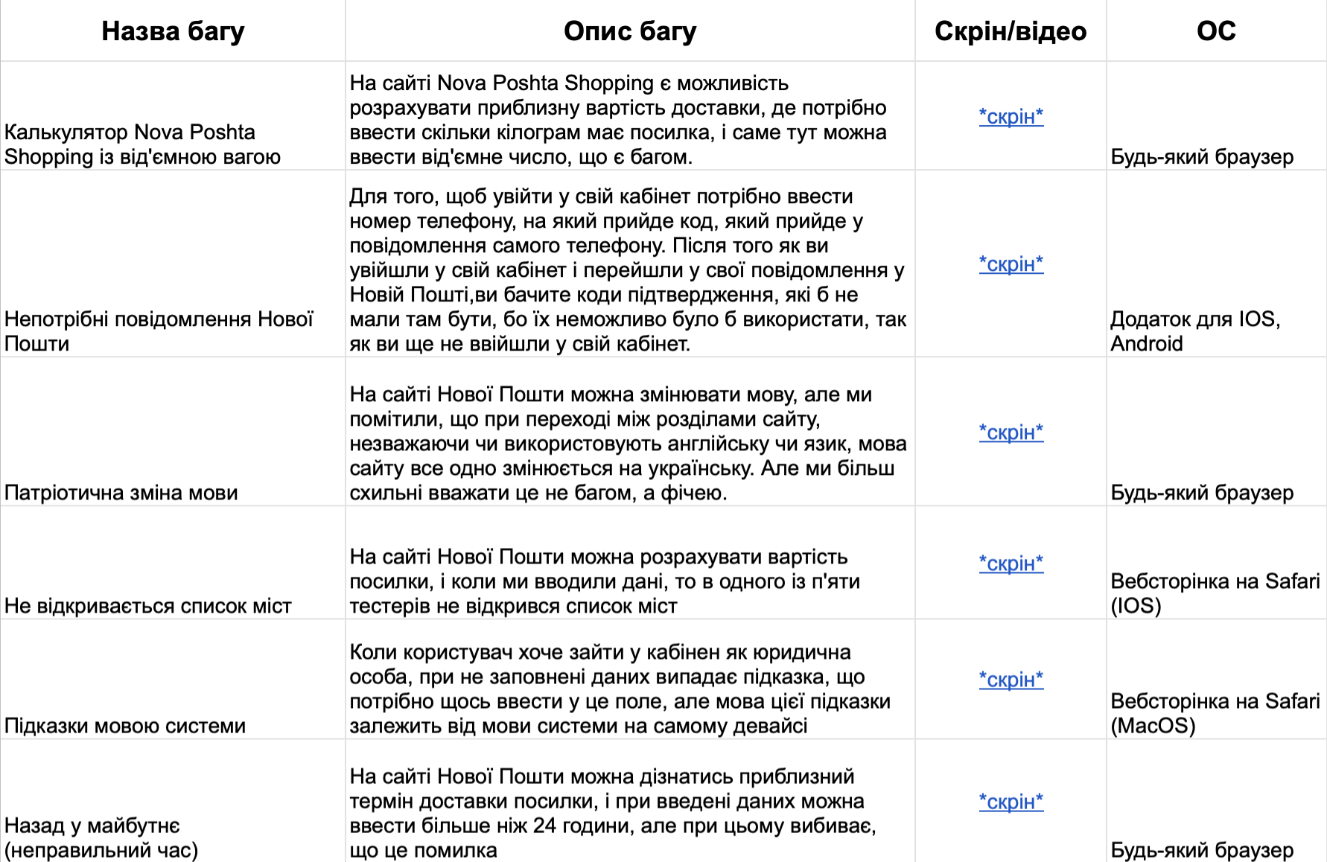
Testing
Types of testing:
Functional testing
Non-functional testing
Structural testing
Testing changes
refers to the actual testing of a product to meet QC standards. This may involve using or stress testing the product or seeing if the actual service results match the expected results. The process identifies problems in the product or service before it goes live.
Not interesting Not interesting Not interesting
Not interesting Not interesting

Slide 36
Agile
In software development, agile (sometimes written Agile)practices include requirements discovery and solutions improvement through the collaborative effort of self-organizing and cross-functional teams with their customer(s)/end user(s),adaptive planning, evolutionary development, early delivery, continual improvement, and flexible responses to changes in requirements, capacity, and understanding of the problems to be solved.

Slide 37
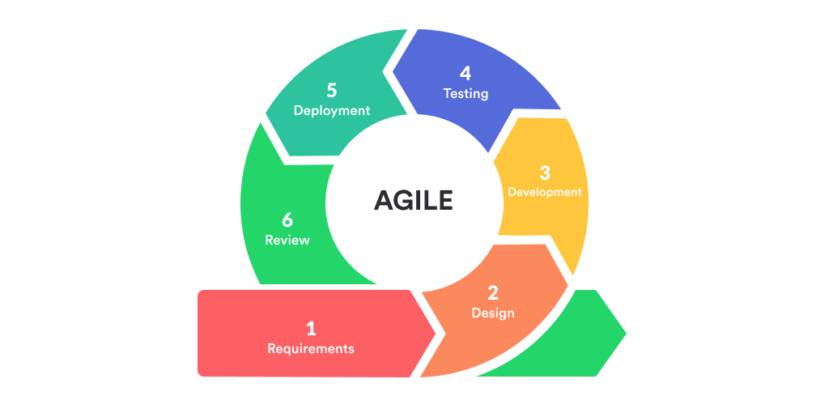
Agile
In software development, agile (sometimes written Agile)practices include requirements discovery and solutions improvement through the collaborative effort of self-organizing and cross-functional teams with their customer(s)/end user(s),adaptive planning, evolutionary development, early delivery, continual improvement, and flexible responses to changes in requirements, capacity, and understanding of the problems to be solved.

Slide 38
Питаннячка
.Still Нема

Slide 39
Питаннячка
.Still Нема
Thank for your attention!

Slide 40
Thank for your attention!

